Slide 1



Immutability that doesn’t make you sick
Aleksandr Kugushev
Notes:
Я раздаю книги коллегам
У меня собака погрызла книгу
Моя коллега носит книжку в файлике

Slide 2

I want you to
Don’t hesitate following the rules this book
Play around with the wording, make your own interpretation
Don’t forget sharing this book with your neighbor

Slide 3
Plan
Advantages of using immutable entities and collections
Techniques to make entities immutable
How to make changes to immutable entity
Myths about immutable collections

Slide 4
Why?
Avoiding unexpected changes in huge code base
In memory cache
Multithreading
Snapshot semantic

Slide 5
Unexpected changes
Result GetResult(Entity entity)
{
/* a lot of code */
var name = GetEntityName(entity);
/* a lot of code */
return LoadResult(
name,
entity.Value);
}
string GetEntityName(Entity entity)
{
string name = entity.Name;
/* a lot of code */
// Bugfix 666
entity.Value = 42;
/* a lot of code */
return name;
}
42 0_o

Slide 6
In memory cache
private readonly Dictionary<int, Entity> cache = new Dictionary<int, Entity>();
void DoSomething(int id)
{
/* a lot of code */
if (!cache.TryGetValue(id, out var entity))
entity = cache[id] = GetEntity(id);
/* a lot of code */
//Bugfix 1313
entity.Name = "Hello World!";
}
0_o "Hello World!"

Slide 7
Multithreading and snapshot semantic
public Entity Entity { get; private set; }
void DoSomething()
{
var entity = Entity;
Console.WriteLine(Entity.Name);
Console.WriteLine(entity.Name);
/* a lot of code */
Console.WriteLine(Entity.Name);
Console.WriteLine(entity.Name);
}
/*---*/
void UpdateEntityName(string name)
{
Entity.Name = name;
}
Thread1
Thread2
RACE! 0_o

Slide 8
Immutable entities
Records
Constructor
Builder
Wrapper
Immutable interface

Slide 9
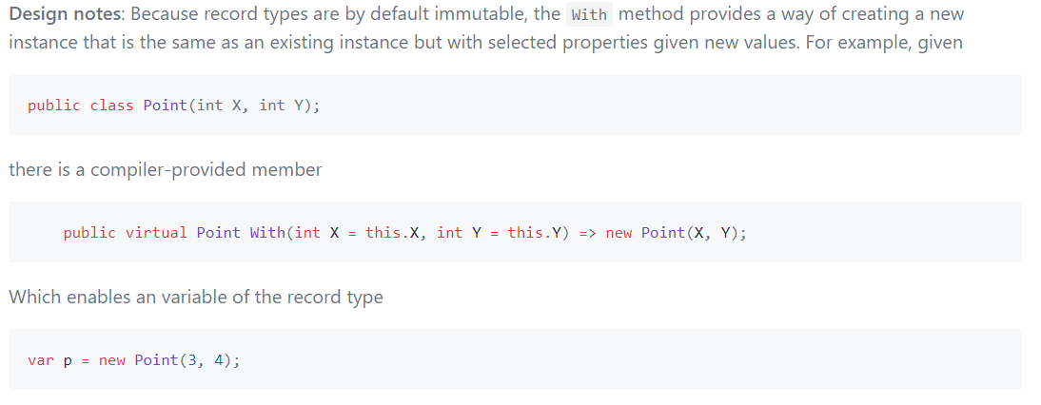
Records

Slide 10
Constructor
class Bicycle
{
public Bicycle(int id, string name)
{
Id = id;
Name = name;
}
public int Id { get; }
public string Name { get; }
}

Slide 11
Constructor ☹
class Car
{
public Car(int id, string model, string modelFull, string mark, int certificate,
int issuerId, string issuePlace, DateTime issueDate, IReadOnlyList<IOwner> owners)
{
Id = id;
Model = model;
ModelFull = modelFull;
Mark = mark;
Certificate = certificate;
IssuerId = issuerId;
IssuePlace = issuePlace;
IssueDate = issueDate;
Owners = owners;
}
/*…*/
}

Slide 12
Constructor +/-
Advantages
Disadvantages
Simple
Well known
No compile time validation
Ugly if big
No deserialization
No Entity Framework

Slide 13

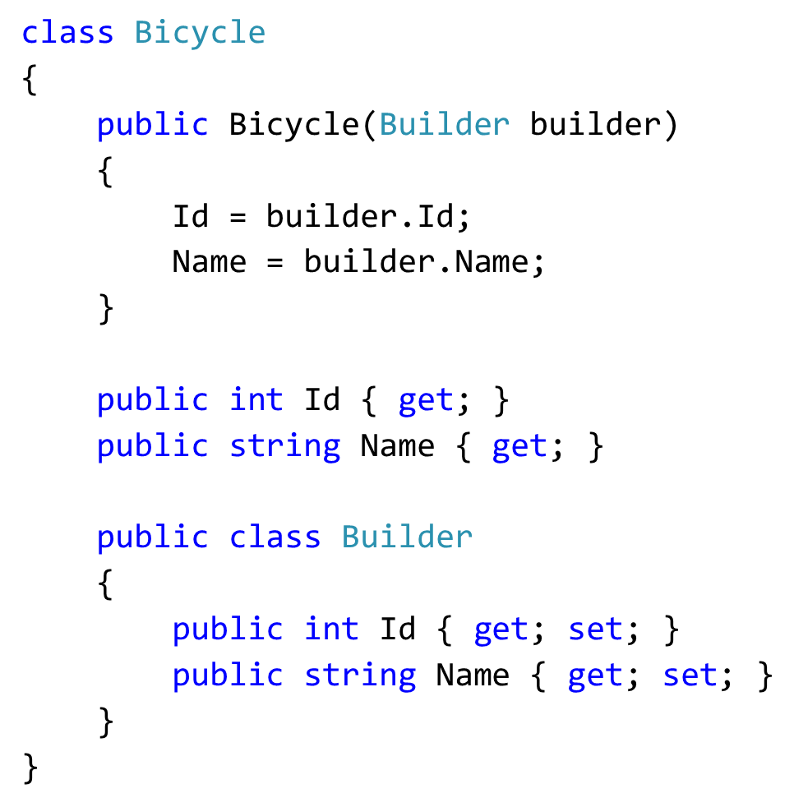
Builder

Slide 14
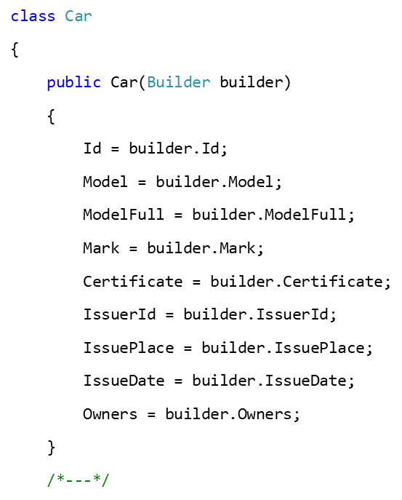
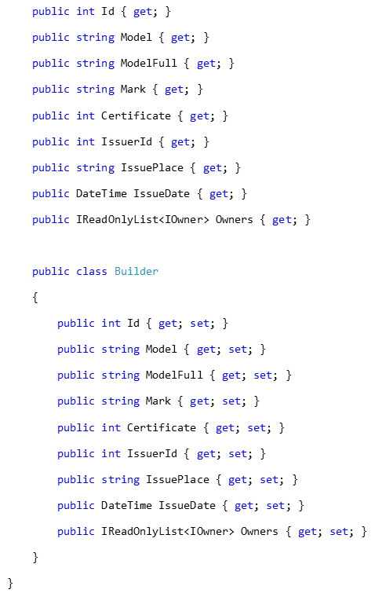
Builder ☹

Slide 15
Builder +/-
Advantages
Disadvantages
Still Simple
Well known
Constructor doesn’t change
Support deserialization
No compile time validation
Ugly if big

Slide 16
Wrapper
class Wrapper<T>
{
public Wrapper(T entity)
public V Get<V>(Func<T, V> getter);
public T Modify(Action<T> builder)
}
void DoSomething(Immutable<Entity> entity)
{
string name = entity.Get(e => e.Name);
Immutable<Entity> renamed = entity
.Modify(e => e.Name = "new name");
}

Slide 17
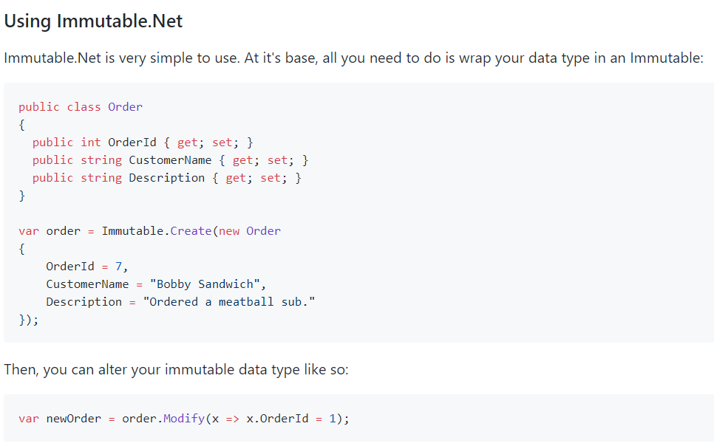
github.com/mattnischan/Immutable.Net

Slide 18
Wrapper: Example
class Credentials<T>
{
/*MUTABLE LEGACY*/
}
class Address
{
/*MUTABLE LEGACY*/
}
class BirthInformation
{
/*MUTABLE LEGACY*/
}
class Owner
{
public Owner(int id, Credentials<RealEntity> credentials, Address address, BirthInformation birthInformation)
{
Id = id;
Credentials = Immutable.Create(credentials);
BirthInformation = Immutable.Create(birthInformation);
Address = Immutable.Create(address);
}
public int Id { get; }
public Immutable<Credentials<RealEntity>> Credentials { get; }
public Immutable<Address> Address { get; }
public Immutable<BirthInformation> BirthInformation { get; }
}

Slide 19
Wrapper +/-
Advantages
Disadvantages
We can use mutable POCO classes!!!
Require external dependency
It makes code a little bit more complicated
Unexpected issues while modifying aggregations

Slide 20
Immutable interface
Available in a creator
Available everywhere
class Bicycle : IBicycle
{
public int Id { get; set; }
public string Name { get; set; }
}
interface IBicycle
{
int Id { get; }
string Name { get; }
}

Slide 21
Immutable interface ☺
interface ICar
{
int Id { get; }
string Model { get; }
string ModelFull { get; }
string Mark { get; }
int Certificate { get; }
int IssuerId { get; }
string IssuePlace { get; }
DateTime IssueDate { get; }
IReadOnlyList<IOwner> Owners { get; }
}
class Car: ICar
{
public int Id { get; set; }
public string Model { get; set; }
public string ModelFull { get; set; }
public string Mark { get; set; }
public int Certificate { get; set; }
public int IssuerId { get; set; }
public string IssuePlace { get; set; }
public DateTime IssueDate { get; set; }
public IReadOnlyList<IOwner> Owners { get; set; }
}

Slide 22
Immutable interface +/-
Advantages
Disadvantages
Compile time validation
Performance
Mutable and immutable states of an entity
Methods via interfaces
Support deserialization
Support Entity Framework
Vulnerable against cast
Required code review

Slide 23
Pattern “With”
class Bicycle
{
// …
public Bicycle WithName(string value)
{
return value == Name
? this
: new Bicycle(Id, value);
}
}

Slide 24
Pattern “With builder”
public ICar With(Action<Car> builder)
{
var clone = (Car)MemberwiseClone();
builder(clone);
return clone;
}
ICar ChangeModel(ICar car)
{
ICar newCar = car.With(
c => c.Model = "Hyundai Solaris");
return newCar;
}

Slide 25
Dangerous “With builder”
class Car : ICar
{
public Owner CurrentOwner { get; set; }
public IEntity With(Action<Car> builder)
{
var clone = (Car)MemberwiseClone();
builder(clone);
return clone;
}
}
class Owner : IOwner
{
public string Name { get; set; }
}
void Test_SellCar()
{
ICar car = new Car
{
CurrentOwner = new Owner
{
Name = "Aleksandr Kugushev"
}
};
ICar soldCar = car.With(e
=> e.CurrentOwner.Name = "Jon Skeet");
Assert.Equal(
"Aleksandr Kugushev",
car.CurrentOwner.Name);
}
0_o "Jon Skeet"

Slide 26
Myth 1: Immutable collections are useless
class Car
{
// ...
public IReadOnlyList<IOwner> Owners { get; private set; }
public Car AddOwners (IOwner owner)
{
return new Car
{
Owners = Owners.Append(owner).ToList()
};
}
}

Slide 27
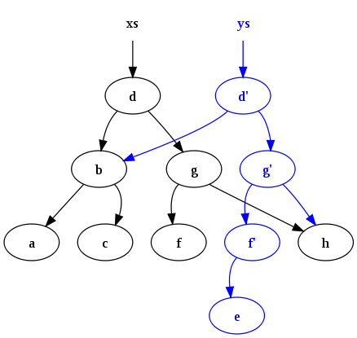
Immutable collections
Instead of comparing immutable collections with a mutable collection we should consider it as an alternative to use mutable collections in an immutable way.

Slide 28
Myth 2: We should use it everywhere
 | Mutable (amortized) | Mutable (worst case) | Immutable
Stack.Push | O(1) | O(n) | O(1)
Queue.Enqueue | O(1) | O(n) | O(1)
List.Add | O(1) | O(n) | O(log n)
HashSet.Add | O(1) | O(n) | O(log n)
SortedSet.Add | O(log n) | O(n) | O(log n)
Dictionary.Add | O(1) | O(n) | O(log n)
SortedDictionary.Add | O(log n) | O(n log n) | O(log n)

Slide 29
Benchmarks: List
[Params(1000)]
public int Count { get; set; }
[GlobalSetup]
public void GlobalSetup()
{
var r = new Random();
BigList = Enumerable.Range(0, Count)
.Select(i => r.Next()).ToList();
BigImmutableList =
ImmutableList.Create<int>(BigList.ToArray());
}

Slide 30
Benchmark: Append
Mean: 1,193.7 ns
Mean: 365.9 ns
[Benchmark]
object List_Add()
{
return BigList
.Append(42)
.ToList()
.AsReadOnly();
}
[Benchmark]
object ImmutableList_Add()
{
return BigImmutableList
.Add(42);
}

Slide 31
Benchmark: Select
Mean: 133,267.5 ns
Mean: 276,739.8 ns
[Benchmark]
object List_Select()
{
return BigList
.Select(i => i.ToString())
.ToList();
}
[Benchmark]
object ImmutableList_Select()
{
return BigImmutableList
.Select(i => i.ToString())
.ToImmutableList();
}

Slide 32
Benchmark: Where
Mean: 3,990.8 ns
Mean: 74,251.9 ns
[Benchmark]
object List_Where()
{
return BigList
.Where(i => i < 100)
.ToList();
}
[Benchmark]
object ImmutableList_Where()
{
return BigImmutableList
.Where(i => i < 100)
.ToImmutableList();
}

Slide 33
Benchmarks: Dictionary
[Params(1000)]
public int Count { get; set; }
[GlobalSetup]
public void GlobalSetup()
{
var r = new Random();
Big = Enumerable.Range(0, Count)
.ToDictionary(i => i, i => r.Next().ToString());
BigImmutable = Big.ToImmutableDictionary();
}

Slide 34
Benchmark: Dictionary Get
Mean: 20.47 ns
Mean: 109.25 ns
[Benchmark]
object Dictianary_Get()
{
return Big[42];
}
[Benchmark]
object ImmutablDictionary_Get()
{
return BigImmutable[42];
}

Slide 35
Benchmark: New Dictionary Set
Mean: 35,392.16 ns
Mean: 4,628.17 ns
[Benchmark]
object Dictianary_Set()
{
var newDict =
new Dictionary<int, string>(Big);
newDict[42] = "123";
newDict.Add(Count + 1, "new");
return newDict;
}
[Benchmark]
object ImmutableDictionary_Set()
{
var newDict = BigImmutable
.SetItem(42, "123");
return newDict
.Add(Count + 1, "new");
}

Slide 36
Useful presentations and articles
Jon Skeet — The changing state of immutability C#
Eric Lippert:
Immutability in C# Part One
Immutability in C# Part Two
…
Dixin's Blog: Functional Programming In-Depth (12) Immutability, Anonymous Type, and Tuple

Slide 37
Conclusion
Know your tools
Immutability is not an extreme
No Fear
https://github.com/AleksandrKugushev/immutability
aleksandr_kugusev@epam.com

